Slide 1
WOCN Society
Region & Affiliate Leadership Workshop
June 21, 2014
Omni Hotel, Nashville, TN

Slide 2
Objectives
Discuss the legal relationship between the WOCN National and the regions and affiliates.
Obtain an understanding of the fundamentals of the WOCN National Office organizational structure and the difference between governance and operations.
Navigation of the WOCN website and tools to promote your professional practice
Understand various elements of financial management and due diligence

Slide 3
Region & Affiliate Guidelines
&
Charter Agreements
Lisa A. Stegink
Chicago Law Partners, LLC
333 West Wacker Drive, Suite 810
Chicago, IL 60606
(312) 929-1966 | www.clpchicago.com

Slide 4
What We’ll Cover Today
What’s the Purpose?
Understanding the WOCN and Regional/Affiliate Structure
Framework for Operation
Key Provisions of Guidelines and Charter Agreements
Input and Next Steps

Slide 5
What’s the Purpose?
Promote common purpose of WOCN Society and its Regions & Affiliates
  advance the practice and guide the delivery of expert health care to individuals with wounds, ostomies and incontinence
Create best practices for consistent operation and more uniform experience for Regions & Affiliates
Minimize potential liability

Slide 6
Overview of WOCN Organizational Structure
WOCN Society is Illinois not-for-profit corporation
  articles of incorporation, bylaws, and policies
  Income tax-exempt under 501(c)(6) as a professional society
  WOCN Foundation is 501(c)(3) charitable arm
Regions & Affiliates are local divisions of WOCN, chartered by WOCN
  part of WOCN Society corporate structure (except Hawaii, which is separately incorporated)

Slide 7
Framework for Operation
Board Policy for status as a Region or Affiliate
Region & Affiliate Charter Agreement
Region & Affiliate Operating Guidelines

Slide 8
Board Policy
Requirements for being designated (“chartered”) by the WOCN Board as a Region or Affiliate of WOCN
Territory, name, officers, members
Regions & Affiliates must operate consistent with WOCN bylaws, policies, rules and law
Recognizes status as part of WOCN’s corporate legal structure

Slide 9
Region & Affiliate Agreement
Establishes and describes the rights and obligations of WOCN Society and the Regions & Affiliates to each other
The Charter Agreement sets forth the terms of:
  region served and membership
  relationship of the parties
  WOCN Society responsibilities
  Region & Affiliate responsibilities
  reporting obligations
  use of WOCN Society trademarks & branding
  termination of charter

Slide 10
Region & Affiliate Responsibilities
Adopt operating guidelines that conform with WOCN Society standard “Operating Guidelines (Bylaws) of the ________ Region/Affiliate of the Wound, Ostomy & Continence Nurses Society”
Promote the interests and support the programs and activities of WOCN on a local basis, consistent with WOCN’s tax-exempt status
Establish accounts under WOCN’s tax ID
Hold regular meetings
Provide reports to WOCN Society on Region/Affiliate finances, budget, board and member meetings, activities and other information (templates)

Slide 11
Region & Affiliate Guidelines
Consistent with WOCN bylaws & policies
Provide uniformity among regions/affiliates
Compliant with Illinois law
Reflect best practices
Clearly stated provisions

Slide 12
Key Provisions
Membership and member rights
Membership meeting and voting requirements
Minimum board of director requirements
Officer positions and duties
Committees
Amendment and dissolution process

Slide 13
Next Steps
Identify “regions of excellence” for contributing their best practices to all Regions & Affiliates
Regions & Affiliates review documents and provide input on policy, affiliation agreement, and standardized operating guidelines
Transition to new framework

Slide 15

Organizational Structure
&
Governance

Slide 16
Board of Directors
Susan Nelson
Mike Dwyer
Chief Relations Officer
Chief Relations Officer
Nicolette
Nicolette
Zuecca
Zuecca
Executive Vice President
Executive Vice President
Vincent Gangemi
Sarah Gazi
Assistant Executive Director
Debi Maines
Chris Brown
Executive Director
Chris Brown
Heather Martinek
Director of Meetings
Senior Exhibits Manager
Exhibit Manager
Assistant Executive Director
Becky Dryden
Publications/Website Manager
Chrissy Kissinger
Committee Liaison Manger
Brooke
Bilofsky
Asst. Mtg. Manager
Lois Hawk
Administrative Assistant
Megan Grant
Membership Coordinator
Caroline Olsen
TBD
Registration Coordinator
Marketing & PR
Kaitlin Loyal
Kate Bowen
Megan Ptaszenski
Education Director
Dorothy Caputo
Government Relations
Chris Rorick
JWOCN
Mikel Gray
Center for Clinical Investigation (CCI)
Donna bliss

Slide 17

Operations vs. Governance
Is There a Difference?

Slide 18
Operations
Policy & Procedure
A policy is any written statement approved by the board or by the membership that:
  Articulates and defines important objectives, principles or values
  Limits or prescribes what kind of action will be taken in different situations
  Defines roles, responsibilities and authority
1999 Non-Profit Sector
Leadership Program
Dalhousie University
Notes:
The board of voluntary and non profit organizations normally govern by establishing policies.

Slide 19

Governance
By-Laws
Matters that relate to the functioning of the Board
Policies that cannot be adopted or changed without approval of the membership at a general meeting
1999 Non-Profit Sector
Leadership Program
Dalhousie University

Slide 20

Volunteer Insurance
Volunteer Protection Act of 1997 which limits the personal liability of Directors state that a volunteer cannot be sued as long as they are;

Slide 21
Director’s & Officers Insurance
(D&O)
The WOCN D&O policy provides 1 million per occurrence up to 2 million total.
WOCN has an umbrella policy to the general liability policy which provides an additional one million above the two million dollar limit.

Slide 22

Event Insurance
WOCN has a Multi Peril Policy-Liability insurance for events (includes regions and affiliates).
One million per occurrence up to two million dollars.
To obtain event insurance coverage for your regional/affiliate

Slide 23
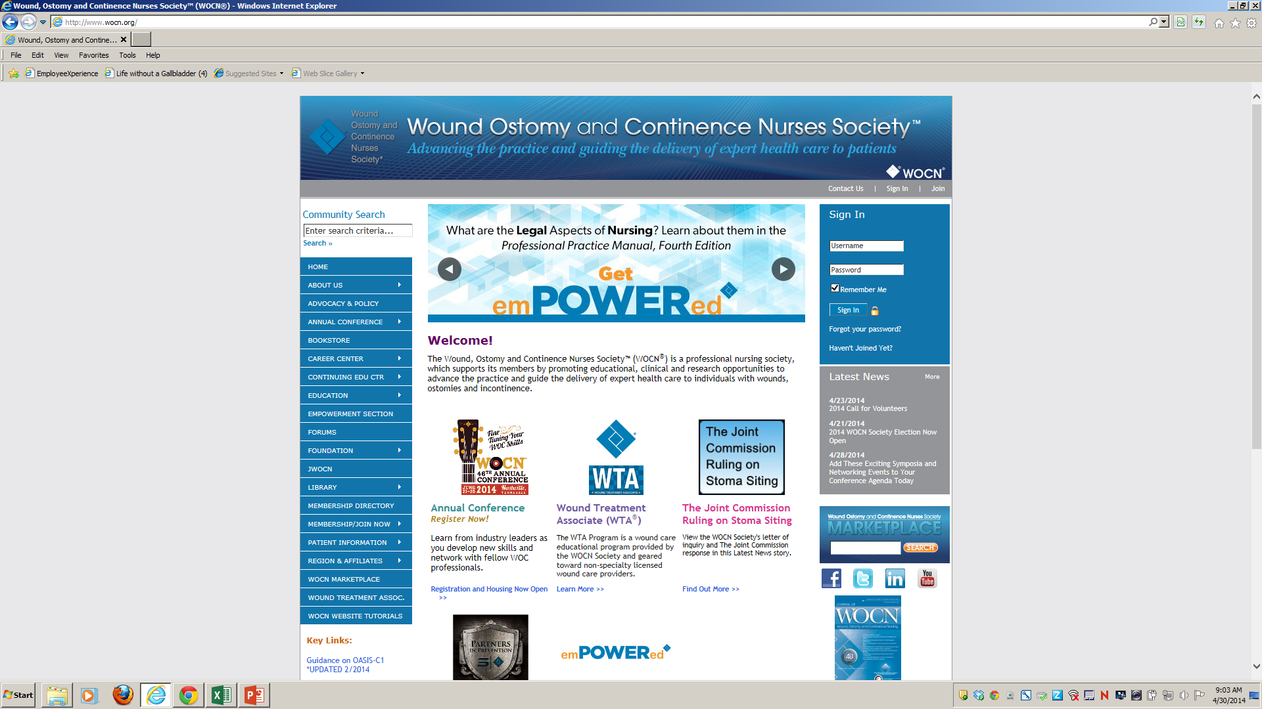
Navigating the WOCN Website & Tutorials
Image Library
WOCN Forums
Member Profile
Member Library
JWOCN
http://www.wocn.org

Slide 24
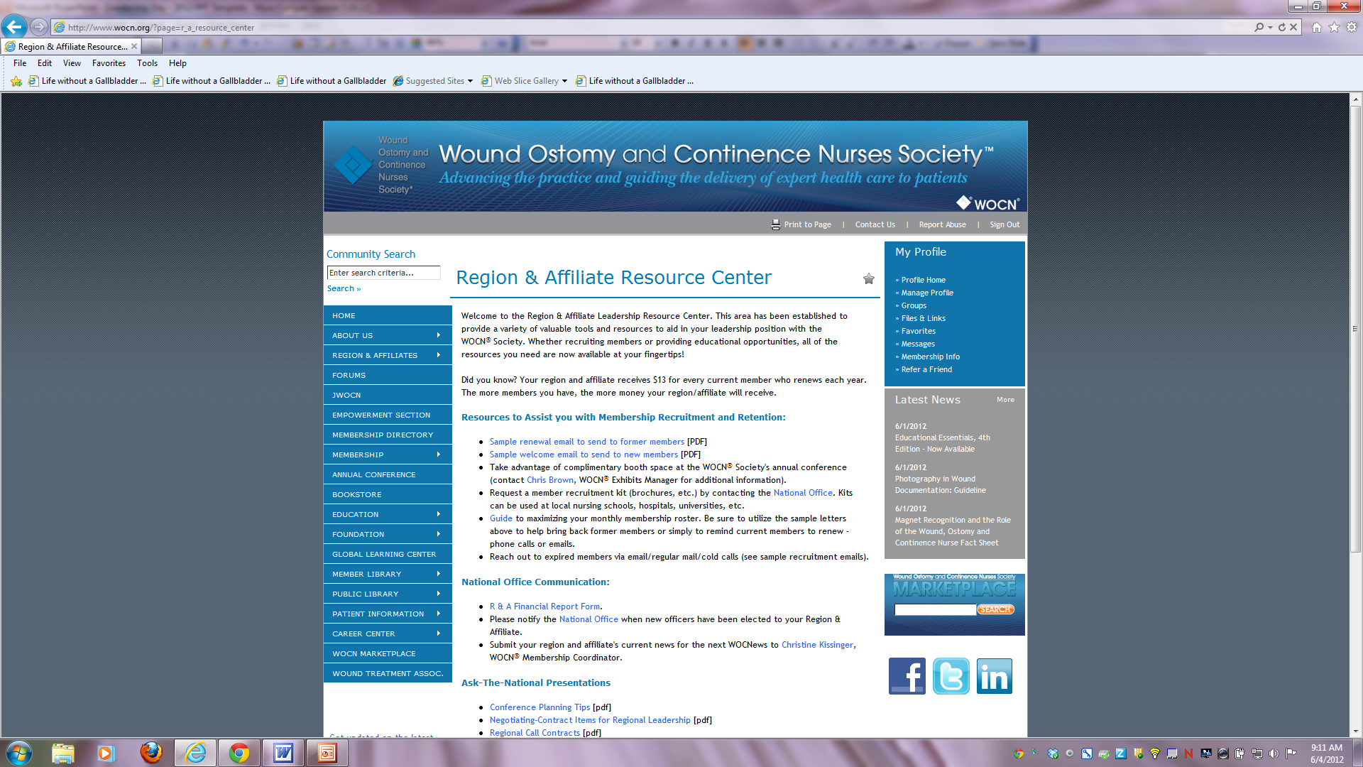
Region & Affiliate Resource Center

Slide 25

The members-only Empowerment section is designed to showcase various documents you can use to demonstrate your value as a WOC nurse.
The members-only Empowerment section is designed to showcase various documents you can use to demonstrate your value as a WOC nurse.

Slide 26

Over 40 contact hours in Wound, Ostomy, Continence and Professional Practice continuing education
Archived webcasts
WOCN Conference Library

Slide 27
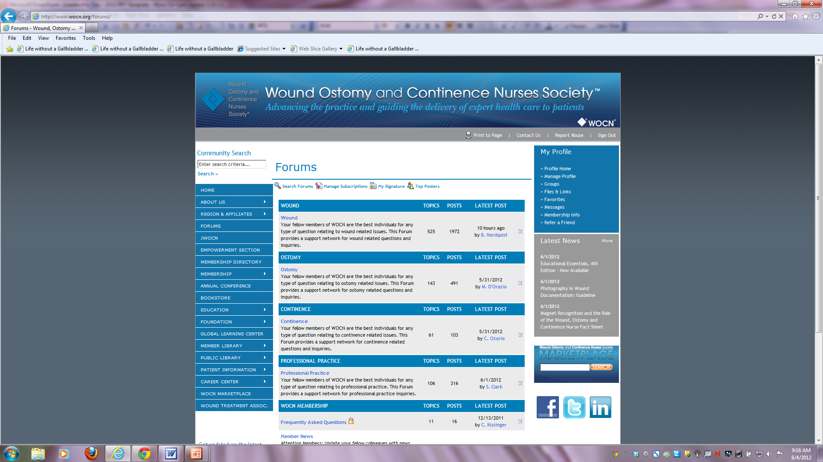

Slide 28

Financial Management

Slide 29

Best Practices
Do not comingle funds
Financial reports
Two signatories
Process for approval of expenses
Annual audit

Slide 30
Budget Preparation
\\Yukon\staff\INDIVIDUAL\NZuecca\WOCN Shared\Conference Info\2014\Leadership\Sample Budget 4.30.14.xlsx

Slide 31
Tax Exemption & Incorporation
The WOCN Society (including regions/affiliates) has been granted 501(c) 6 tax exemption status by the IRS.
The IRS has designated WOCN Employer Identification Number 25-1251887 to be used for proof of income tax exemption.
WOCN Headquarters submits an annual 990 Form on behalf of the Society and regions and affiliates.
The WOCN Society is incorporated in the state of Illinois and is bound by the rules of that state.

Slide 32
Year End Financial Report
\\Yukon\staff\INDIVIDUAL\NZuecca\WOCN Shared\Conference Info\2014\Leadership\R&A Financial Form 4.31.13.xls

Slide 33

WOCN Advocacy In Action

Slide 34
WOCN Health Care Agenda Guiding Principle
Guiding Principle: The purpose of the WOCN Society’s Health Care Agenda is to promote public policy and advocacy activities that are related to the Society’s mission, vision and strategic goals.

Slide 35
WOCN Health Care Agenda
1. Access to Wound, Ostomy and Continence Supplies
  Goal: Protect and enhance patients’ access to wound, ostomy and continence supplies
2. Payment Reform
  Goal: Ensure that patients have access to WOC specialty
nursing services
3. Nursing Workforce and Education
  Goal: WOCN Society advocates for adequate funding of programs for the development and education of nursing’s workforce, including Title 9 of the Public Health Services Act to support the recruitment, education, and retention of the nation’s nursing work force
4. Quality of Care Initiatives
  Goal: Active participation in policy and regulatory development.

Slide 36


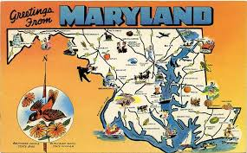

Access to WOC Supplies
Notes:
WOCN has been engaged in ongoing review of the competitive bidding program and continue to seek input form members on the impact of competitive bidding on patient access to supplies and access to DME. Phase 2 is rolling out and the number of areas across the country that are being enrolled in CB is growing. This list of product categories is also growing and will include NPWT, wheel chairs, pressure redistribution mattresses and enteral feeding.
State focused initiatives that include champion WOC nurses seeking mandatory legislation for ostomy supply coverage in the states of New York and Maryland. The Society is working in tandem with the UOAA and the WOC nurses in these states with pending legislation in the committee.

Slide 37
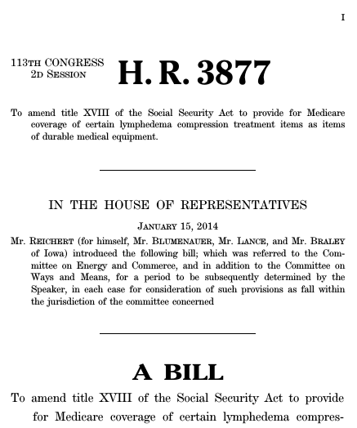
Access to WOC Supplies
  DME Face to Face Requirements
  Biologics and Skin Substitutes
  HR 3877 Lymphedema Coverage
  CMS Competitive Bidding
Notes:
WOCN has supported with the nursing community the inclusion of Advanced Practice Nurses as acceptable providers of face to face assessment. We are following closely the issues of access to care by vulnerable populations that have issues with access to preventative care DME due to the face to face requirement.
2. WOCN support with letter tying components of compression with lymphedemia and chronic venous stais disease.

Slide 38



Access to WOC Nurses
WOCN/ASCRS Joint Position Statement on the value of preoperative stoma site marking for patients undergoing fecal ostomy surgery
WOCN/AUA Joint Position Statement on the value of preoperative stoma site marking for patients undergoing urinary ostomy surgery
  Scope of Practice Issues In the States

Slide 39
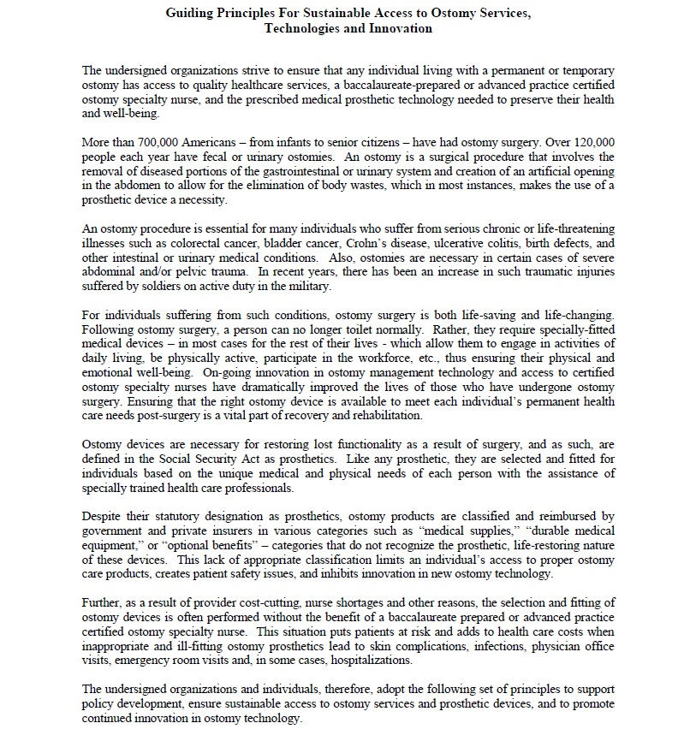
Access to WOC Nurses
Guiding Principles for Sustainable Access to Ostomy Services, Technologies and Innovation
Notes:
Ostomy Guiding Principles promotes both access to supplies and access to clinical experts: WOC Nurses. We have a total of 12 organizations who agreed to sign on and support this document.

Slide 40





Nursing Workforce & Education
&
Quality of Care
Notes:
Nursing workforce-Continue to support the Nursing Caucus title 8
Quality of Care-Participation in CAUTI reduction workgroup. 4 representatives shared with ANA goal to develop an evidence based tool for foley reduction and alternative urinary incontinence management
Engaged in ongoing participation in nominations for panels with NQF
OASIS Refinement Task Force

Slide 41


Slide 42
References
©1999 Non-Profit Sector Leadership Program, Dalhousie University.

